Slide 1


EMPLOYEE DATA ANALYSIS
STUDENT NAME : HARISH J
REGISTER NO : D22AF022
DEPARTMENT : ACCOUNTING & FINANCE
COLLEGE : PATRICIAN COLLEGE OF ARTS & SCIENCE

Slide 2
PROJECT TITLE
EMPLOYEE DATA ANALYSIS USING EXCEL

Slide 3
AGENDA
PROBLEM STATEMENT
PROJECT OVERVIEW
END USERS
OUR SOLUTION AND PROPOSITION
DATASET DESCRIPTION
WOW IN OUR SOLUTION
MODELLIG
RESULTS
CONCLUSION

Slide 4
PROBLEM STATEMENT
I WANT TO KNOW ABOUT THE DIFFERENCE BETWEEN MALE EMPLOYEES AND FEMALE EMPLOYEES IN AN ORGANIZATION AND WANT TO KNOW ABOUT WHICH DOES THE EMPLOYEE BELONGS TO. SO I AM DOING THIS PROJECT

Slide 5
PROJECT OVERVIEW
IN THIS PROJECT I AM GOING TO FIND OUT THE DIFFERENCE BETWEEN THE NUMBER OF MALE AND FEMALE EMPLOYEES AND FROM WHICH CITY THEY ARE COMING WITH THE HELP OF MS EXCEL AND ITS VARIOUS FUNCTIONS

Slide 6

WHO ARE THE END USERS?
This Photo by Unknown Author is licensed under CC BY-NC

Slide 7
OUR SOLUTION AND ITS VALUE PROPOSITION
TO SOLVE MY PROBLEM, I HAVE COLLECTED DATA SET OF EMPLOYEES WITH INFORMATION REGARDING GENDER, LEAVE OUT, BENCHED OUT,CITY. I WILL BE USING VARIOUS FUNCTIONS OF MS EXCEL TO FIND OUT SOLUTION

Slide 8
DATA SET DESCRIPTION
FEATURES OF DATA SET:
ID
GENDER
CITY
BENCHED OUT
LEAVE OUT
EXPERIENCE
THE DATA SET HAS BEEN EXTRACTED FROM KAGGLE

Slide 9
THE “WOW” IN OUR SOLUTION
FUNCTIONS AND FORMULAS
DATA ANALYZING AND VISUALIZATION
ORGANIZING AND FORMATTING WORKSHEETS
SHORTCUT AND PRODUCTIVITY TIPS
SOLVING PROBLEMS AND CHALLENGES

Slide 10
MODELLING
a)MS EXCEL:
MICROSFT EXCEL ENABLES USERS TO FORMAT, ORGANIZE AND CALCULATE DATA IN SPREADSHEET.
b)SORTING FUNCTION:
SORTING HELPS TO ORGANIZE DATA. YOU CAN SORT A TEXT COLUMN IN ALPHABETICAL ORDER (A – Z OR Z – A ). WE CAN SORT A NUMERICAL FORM LARGEST TO SMALLEST OR SMALLEST TO LARGEST.
c)FILTER FUNCTION:
FILTER IS AN ESSENTIAL TOOL HELPS TO DISPLAY RELEVANT DATA. IT ELIMINATES THE IRRELEVANT ENTRIES TEMPORARILY FROM THE VIEW.

Slide 11
d)KAGGLE:
KAGGLE IS A SUBSIDIARY OF GOOGLE. IT IS AN ONLINE COMMUNITY OF DATA SCIENTIST AND MACHINE LEARNING ENGINEERS. IT ALLOWS USERS TO FIND DATASETS THEY WANT TO USE IN BUILDING AI MODELS, PUBLISH DATASETS, WORK WITH OTHER DATA SCIENTIST AND MACHINE LEARNING ENGINEERS AND ENTER COMPETETIONS TO SOLVE DATA SCIENCE CHALLENGES.

Slide 12
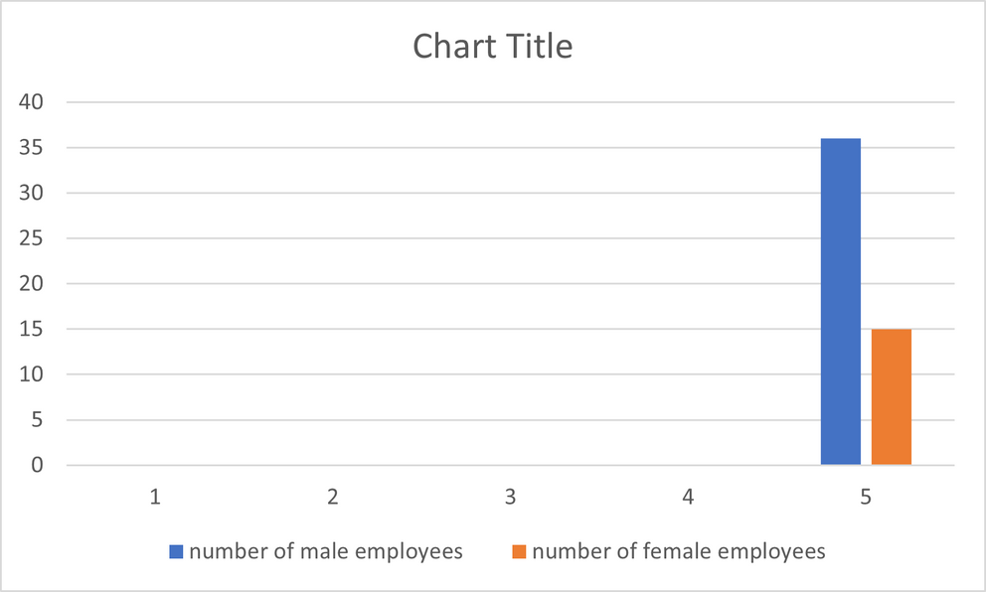
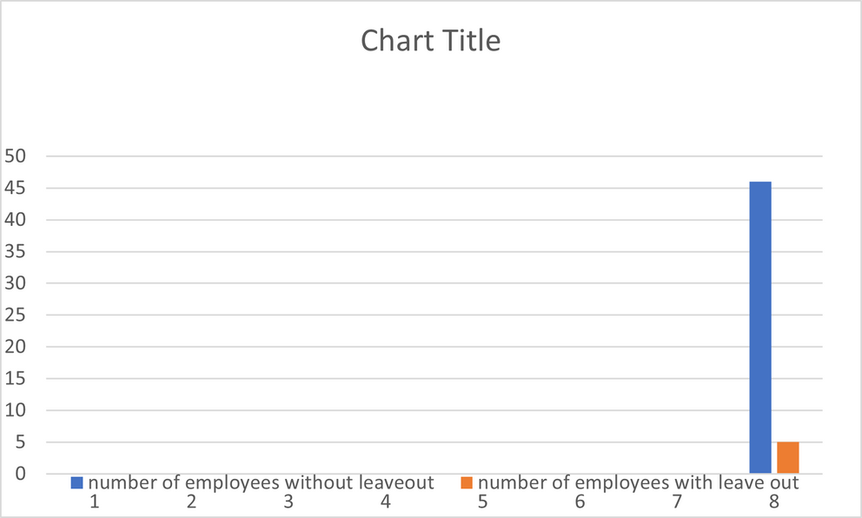
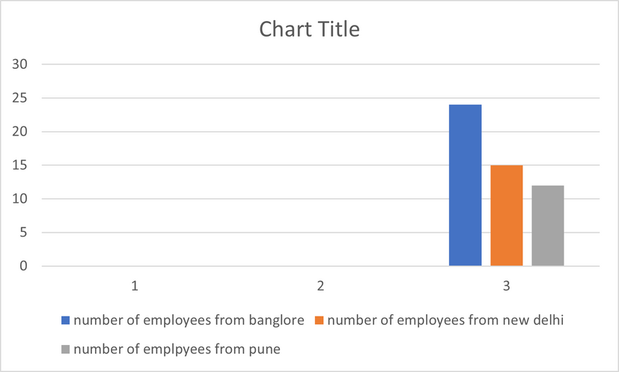
RESULT

Slide 13
CONCLUSION
I HAVE FOUND OUT THAT THERE MORE MEN EMPLOYEES THAN FEMALE EMPLOYEES. ONLY LESS EMPLOYEES WERE BENCHED OUT AND LEAVE OUT. EMPLOYEES ARE BELONGING TO THREE DIFFERENT CITIES.

